Slide 1
Apprentissage continu pour la classification des consommables de santé
Présenté par:
Lmouden Taher - Mohamed Demes
Encadré par:
Hamidi Massinissa

Slide 2
Plan
01
02
03
Introduction
Fine tuning
Apprentissage Few-shots
04
05
Conclusion
Apprentissage continu
02

Slide 3

01
Introduction au projet
03

Slide 4
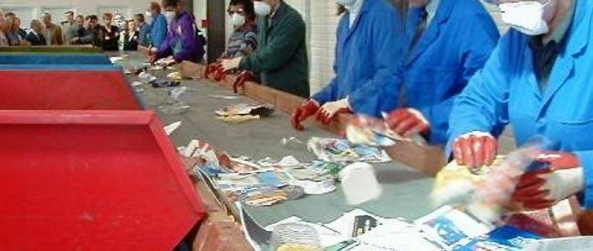
Problématique
les coûts des déchets de soins de santé étaient estimés à 36 milliards de dollars en 2020[1].
La dépendance envers l'intervention humaine.
[1] Conseil de recyclage des plastiques de santé
04

Slide 5


Objectifs
Solution intelligente
Autonome et durable
Utilisation de l’intelligence artificielle et l’internet des objets pour la classification des déchets.
Adaptation au nouveaux types de déchets.
05

Slide 6
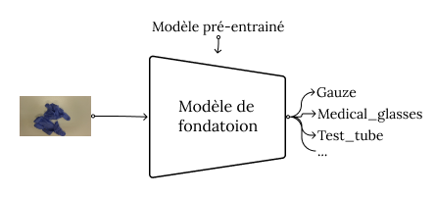
Démarche scientifique
1
2
3
Fine-tuning
Cadre du Few-Shots
Cadre d’
apprentissage continu
06

Slide 7
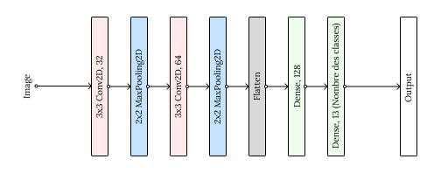
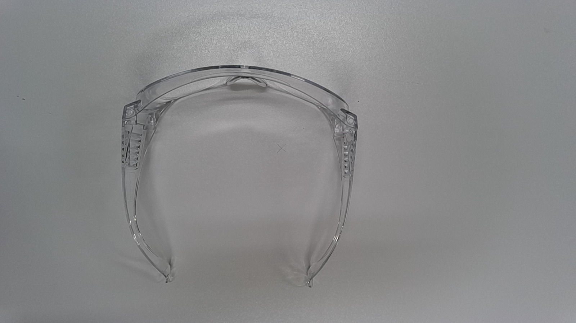
Modèles d’apprentissage
Medical_glasses
07

Slide 8
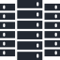


Modèles de fondation
Généralisation aux différentes tâches
Transfert d’apprentissage
Entraîné sur une
grande quantité
de données
Exemples: ChatGPT - MistralAI - Gemma - ViT - ResNet-50 etc.
08

Slide 9
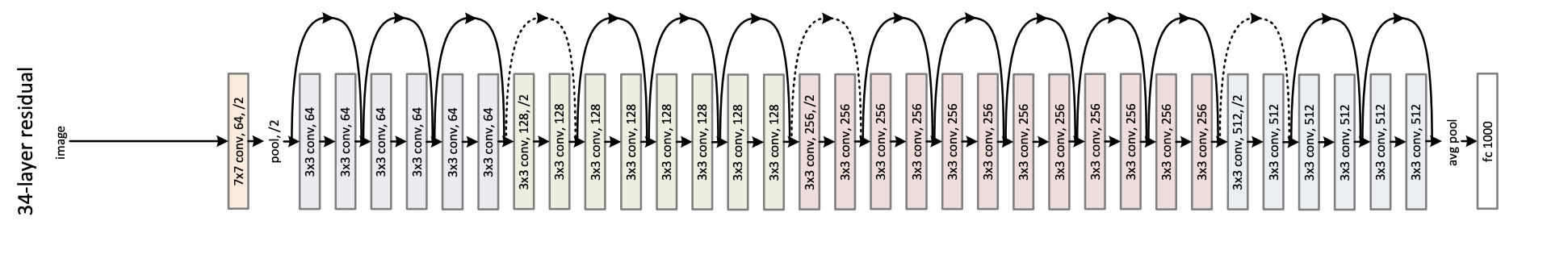
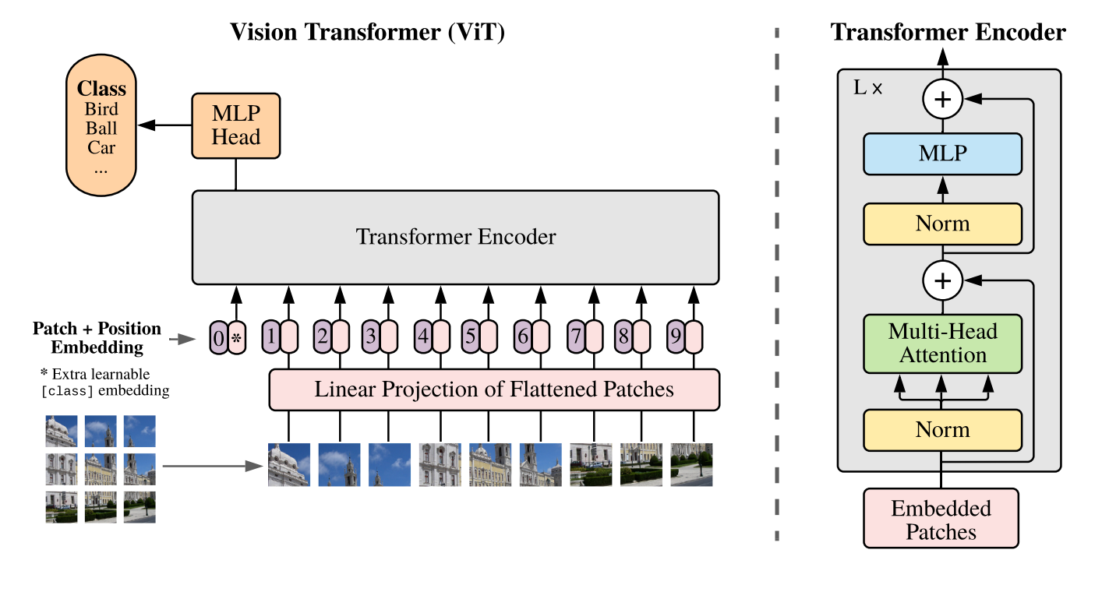
Modèles
Modèles de fondation:
Nom | Nombre de paramètres | Dataset de pré-entraînement
 |  | Nom | Nombre d’images | Nombre de classes
ViT | 86.6 Millions | ImageNet-21K | 14 Millions | 1000
ResNet-50 | 25.6 Millions | ImageNet-1K | 1 Million | 1000
Architectures des modèles:
ResNet-50
ViT
Réseau de neurones simple
09

Slide 10

02
Fine tuning
10

Slide 11
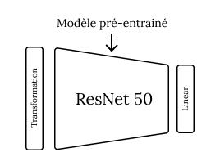
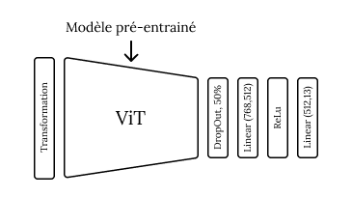
Fine-tuning
Architectures des modèle en fine-tuning:
ResNet-50
ViT
11

Slide 12

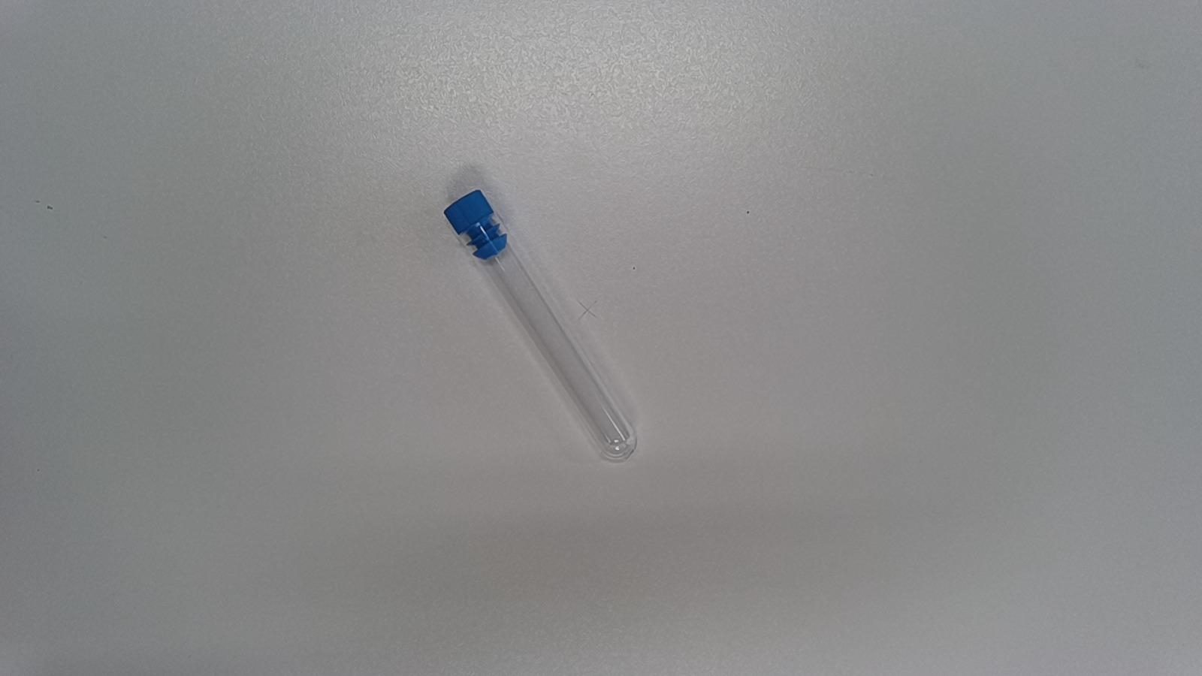
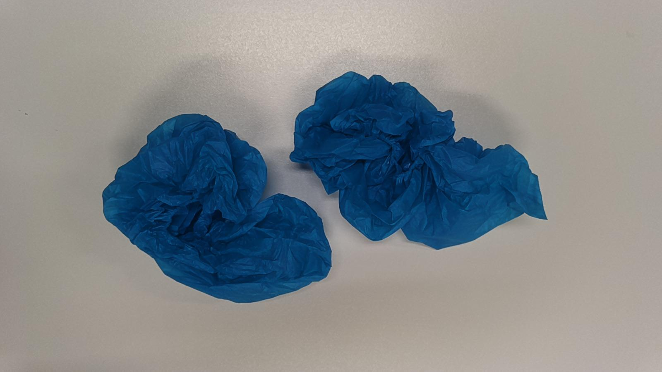
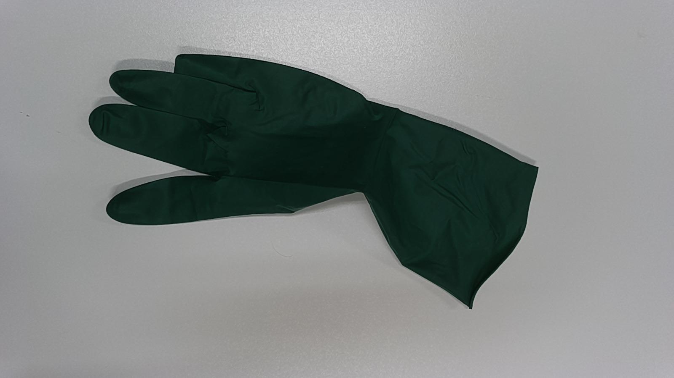
Dataset
Nom | Medical-Waste-4.0-Dataset
Nombre d’images | 4245 images
Nombre de classes | 13 classes
Distribution du dataset | 70% pour l’entrainement (2967 images)
 | 15% pour la validation (629 images)
 | 15% pour le test (649 images)
Exemples:
medical_glasses
test_tube
shoe_cover_pair
glove_single_surgery
12

Slide 13
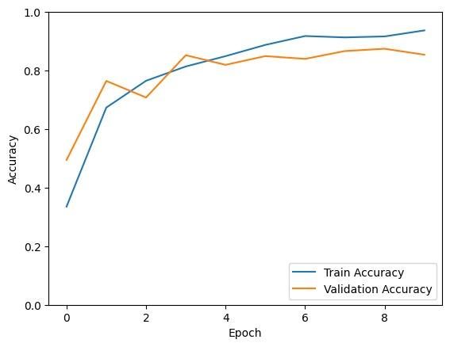
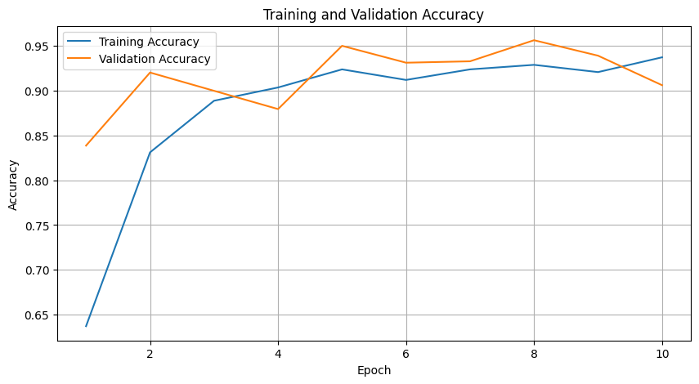
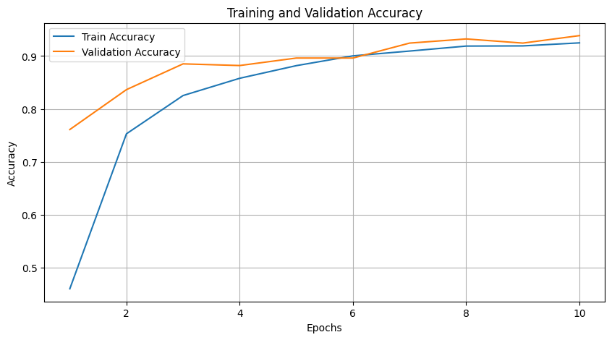
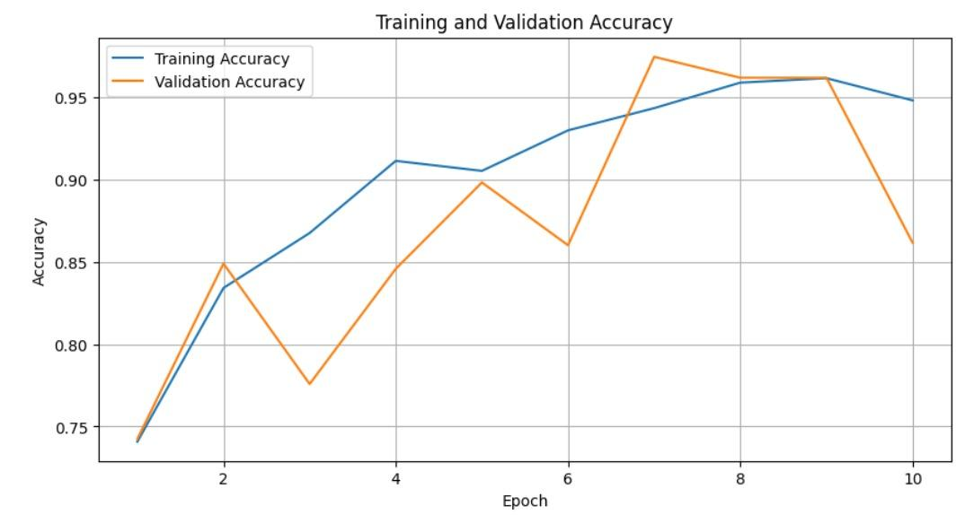
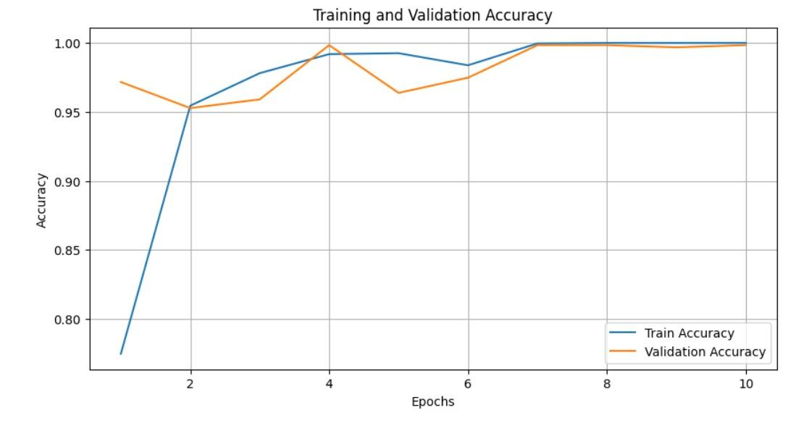
Fine-tuning
Paramètres figées:
Réseau de neurones simple (acc: 86.34%)
ResNet-50 (acc: 88.67%)
ViT (acc: 92.47%)
Paramètres non-figées:
Réseau de neurones simple (acc: 86.34%)
ResNet-50 (acc: 84.43%)
ViT (acc: 99.84%)
13

Slide 14
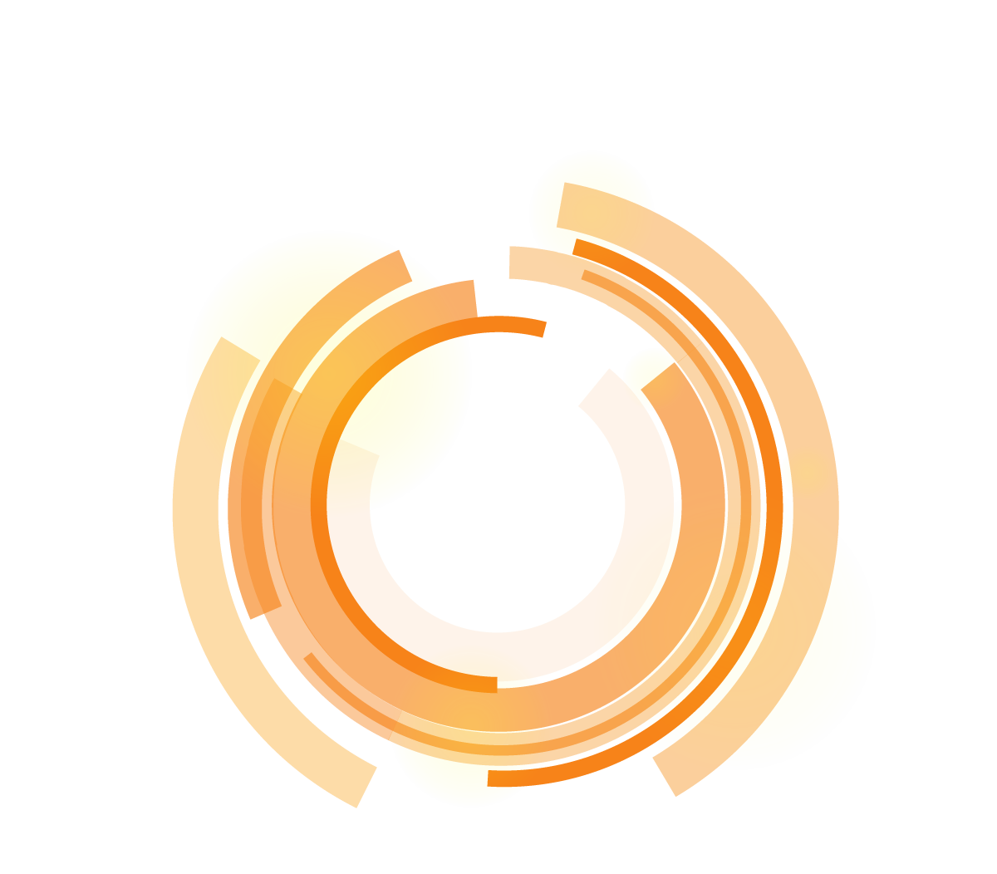
03
Apprentissage few-shots
14

Slide 15


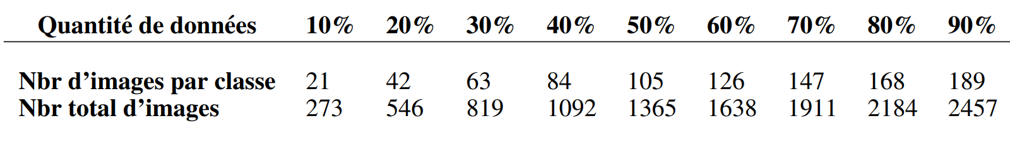
Apprentissage Few-Shots
Quantité de données limitée
Flexibilité et généralisation
Entraînement à partir d'un petit nombre d'exemples.
Compréhension abstraite des données et des concepts, permettant au modèle de tirer des conclusions sur de nouveaux exemples.
15

Slide 16
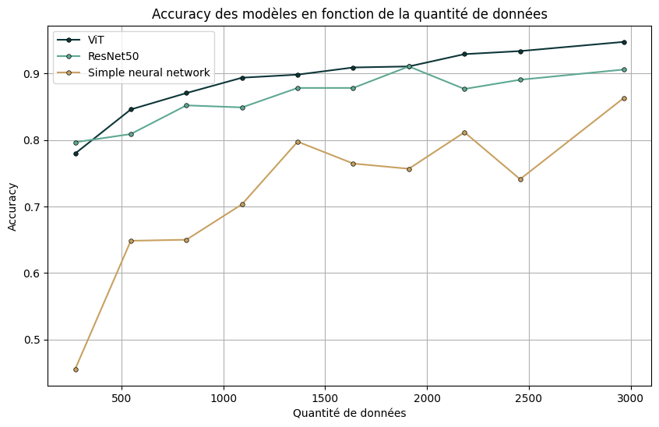
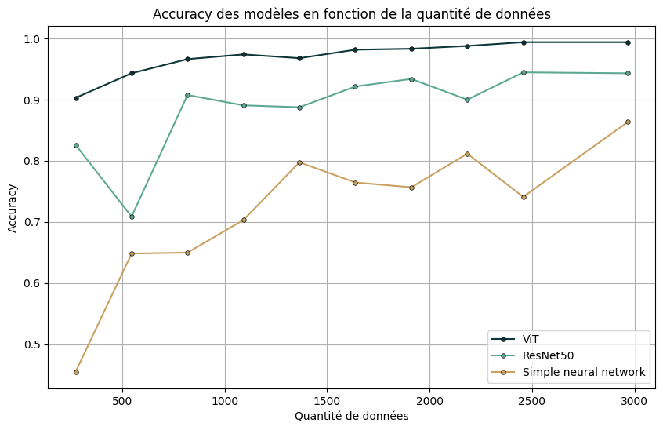
Few-Shots
Paramètres figées:
Paramètres non-figées:
16

Slide 17
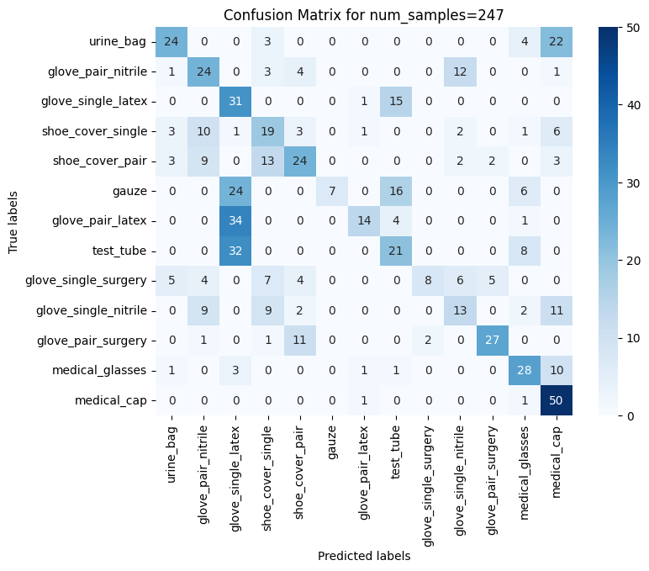
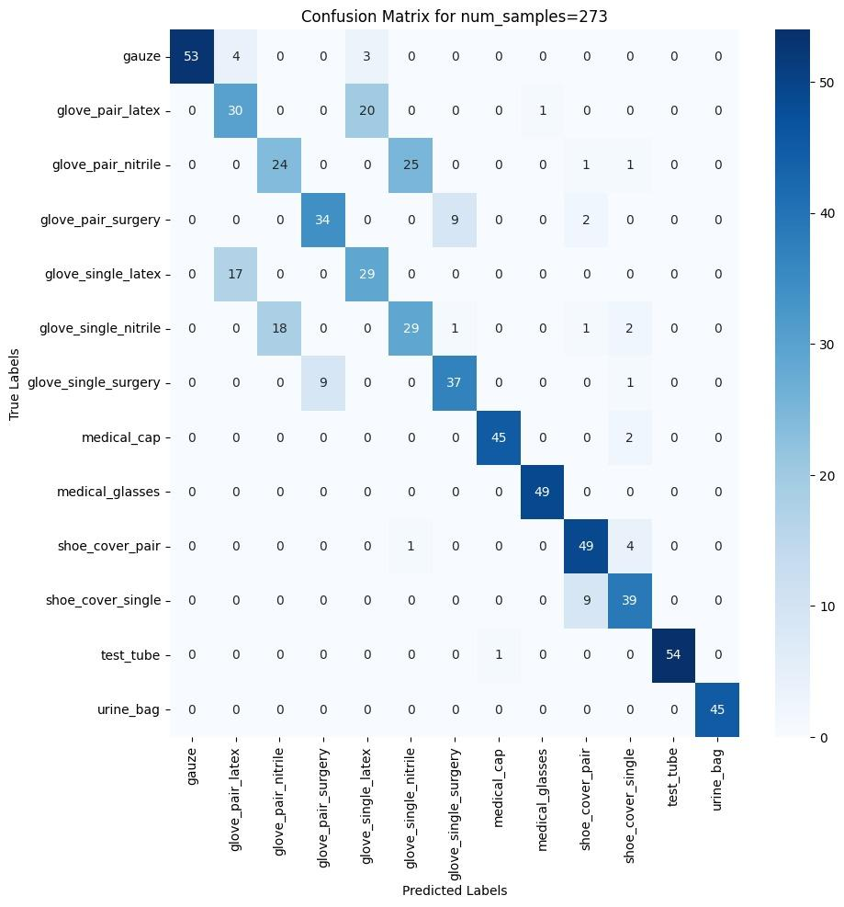
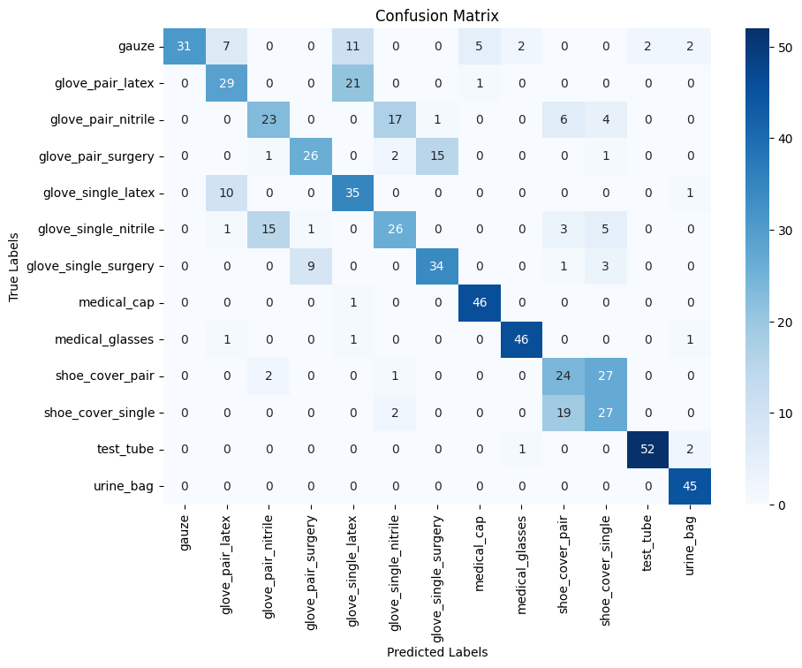
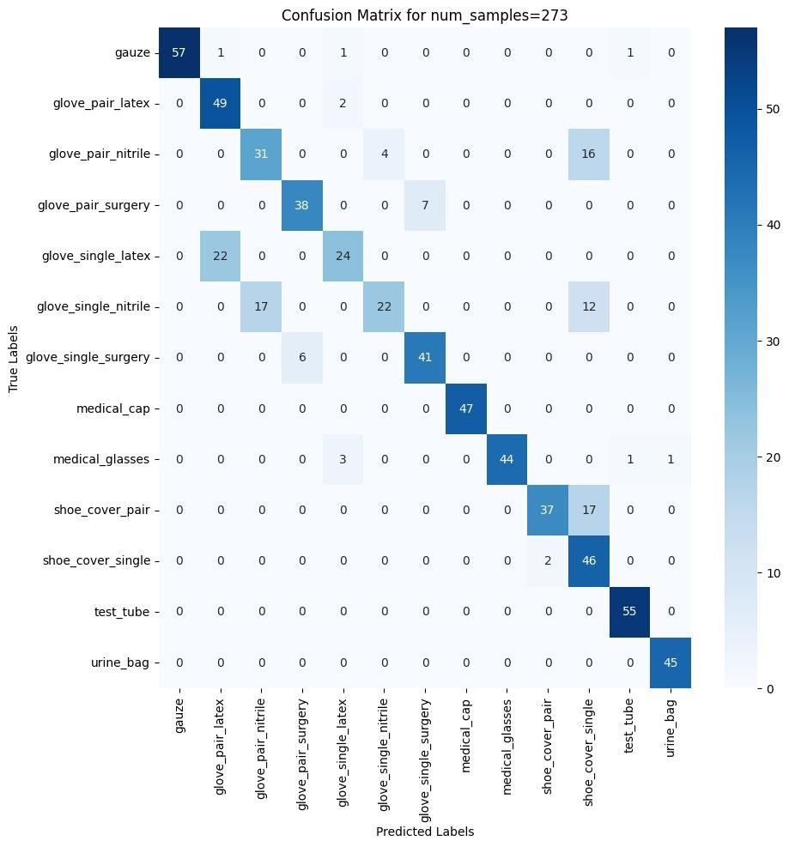
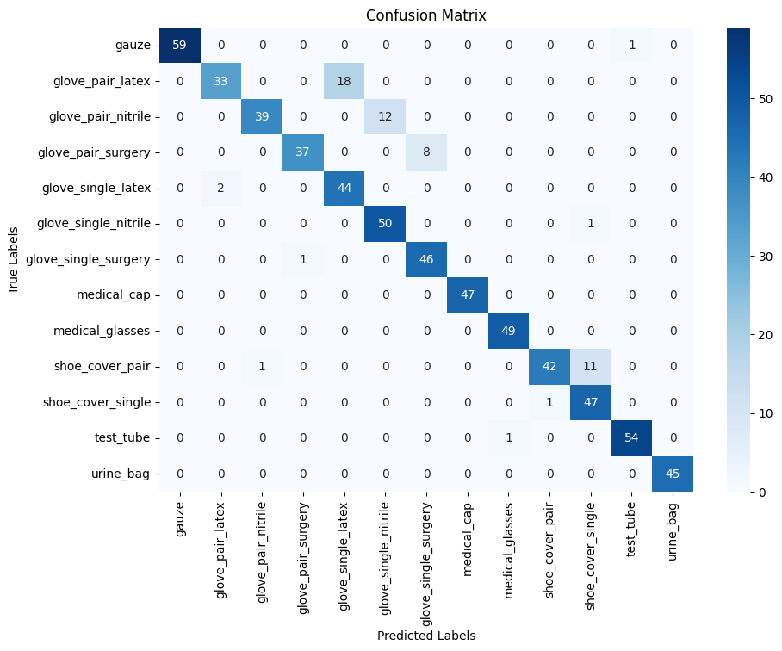
Few-Shots
Paramètres figées:
Réseau de neurones simple (acc: 45.52%)
ResNet-50 (acc: 79.66%)
ViT (acc: 77.96%)
Paramètres non-figées:
Réseau de neurones simple (acc: 45.52%)
ResNet-50 (acc: 82.58%)
ViT (acc: 90.29%)
17

Slide 18

04
Apprentissage continu
18

Slide 19



Apprentissage continu
Régularisation
Architecturale
Basée sur la mémoire
Transfert des connaissances de l’ancien modèle vers le modèle en cours d'entraînement.
Modification de la structure du modèle.
Conservation des échantillons, pour les intégrer dans les prochains entraînements.
19

Slide 20
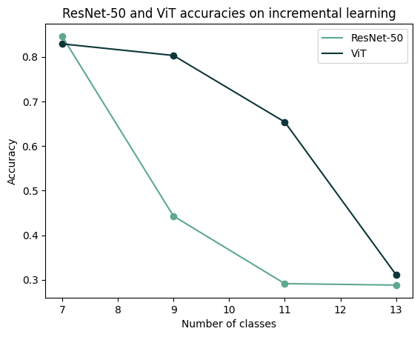
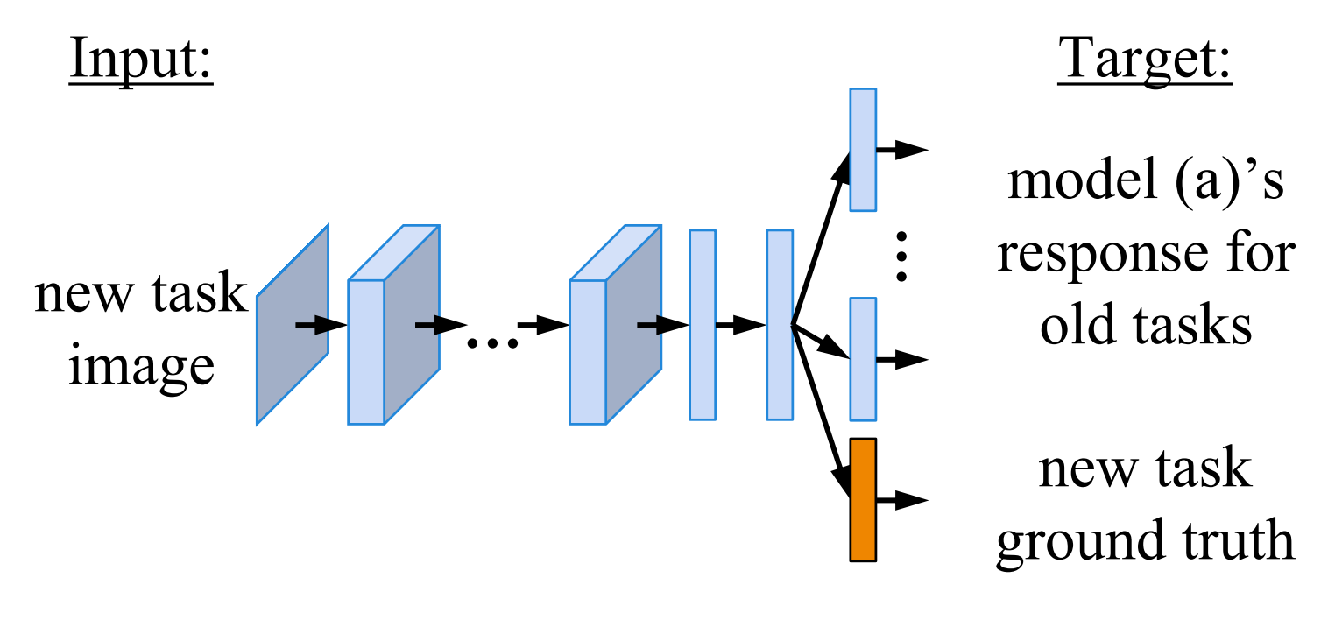
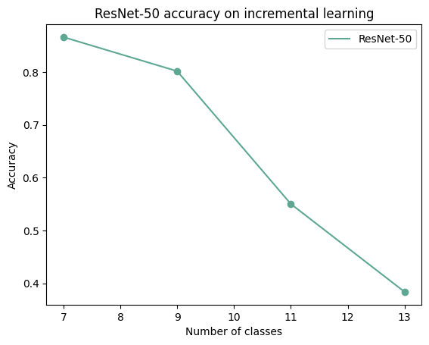
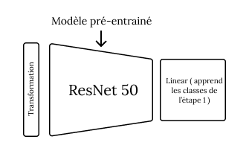
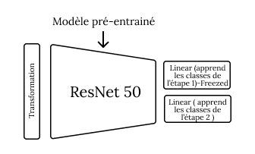
Apprentissage continu
Approche de régularisation:
Architecture du Learning without forgetting
Accuracy des modèles en apprentissage incrémental
Approche architecturale:
Architecture de l’approche architecturale
Accuracy des modèles en apprentissage incrémental
20

Slide 21

05
Conclusion et perspectives
21

Slide 22
Conclusion
01
02
03
Exploration des modèles de foundation dans le cadre de Few-shots et d’apprentissage continu
Concrétisation de la solution
Utilisation de l’IA pour la gestion des déchets médicaux
22

Slide 23
Merci pour votre attention!
23

Slide 25
Expériences
1
2
3
Fine-tuning
Cadre du Few-Shots
Cadre d’
apprentissage continu

Slide 26
Technology Infographics
Saturn
It’s a gas giant and has several rings
Jupiter
Jupiter is the biggest planet of them
Neptune
It’s the farthest planet from the Sun
Mars
Despite being red, Mars is cold
Mercury
It’s the closest planet from the Sun
Earth
Earth is the third planet from the Sun

Slide 27
Technology Infographics
Jupiter
Saturn
Jupiter is the biggest planet of them all
It’s a gas giant and has several rings
Mars
Neptune
Despite being red, Mars is actually cold
It’s the farthest planet from the Sun
Earth
Mercury
Earth is the third planet from the Sun
It’s the closest planet from the Sun

Slide 28
Technology Infographics
Jupiter
Jupiter is the biggest planet in the Solar System
Mars
Despite being red, Mars is actually a cold place
Neptune
Neptune is the farthest planet from the Sun

Slide 29
Technology Infographics
Mars
Jupiter
Despite being red, Mars is actually cold
25%
35%
Jupiter is the biggest planet of them all
Earth
Neptune
Earth is the third planet from the Sun
10%
40%
Neptune is the farthest planet from the Sun

Slide 30
01
Saturn is a gas giant and has several rings
Technology Infographics
02
Despite being red, this planet is actually a cold place
03
Mercury is the closest planet from the Sun
04
Neptune is the farthest planet from the Sun

Slide 31
Technology Infographics
Jupiter
Saturn
Jupiter is the biggest planet of them all
03
04
It’s a gas giant and has several rings
Mars
02
05
Neptune
Despite being red, Mars is actually cold
It’s the farthest planet from the Sun
Earth
01
06
Mercury
Earth is the third planet from the Sun
It’s the closest planet from the Sun

Slide 32
Technology Infographics
Jupiter
Mars
Saturn
Neptune
Jupiter is the biggest planet of them all
Despite being red, Mars is actually a cold place
Saturn is a gas giant and has several rings
Neptune is the farthest planet from the Sun

Slide 33
1
Jupiter
Jupiter is the biggest planet of them all
4
Neptune
Technology Infographics
Neptune is the farthest planet from the Sun
2
Mars
Despite being red, Mars is actually cold
5
Earth
Earth is the third planet from the Sun
3
Saturn
Saturn is a gas giant and has several rings

Slide 34
Technology Infographics
1
6
Jupiter
Saturn
Jupiter is the biggest planet of them all
It’s a gas giant and has several rings
2
5
Mars
Neptune
Despite being red, Mars is actually cold
It’s the farthest planet from the Sun
3
4
Earth
Mercury
Earth is the third planet from the Sun
It’s the closest planet to the Sun

Slide 35
Technology Infographics
Jupiter
Mercury
Jupiter is the biggest planet
It’s the closest planet of the Sun
Neptune
Earth
It’s the farthest planet from the Sun
It’s the third planet from the Sun
Saturn
Mars
It’s a gas giant and has several rings
Despite being red, it’s a cold place

Slide 36
Technology Infographics
Jupiter
Mercury
Jupiter is the biggest planet of them all
It’s the closest planet of the Sun
Neptune
Earth
It’s the farthest planet from the Sun
It’s the third planet from the Sun
Saturn
Mars
It’s a gas giant and has several rings
It’s actually a cold place

Slide 37
Technology Infographics
Saturn
Earth
It’s a gas giant and has several rings
It’s the third planet from the Sun
Jupiter
Neptune
Mercury
Jupiter is the biggest planet of them all
It’s the farthest planet from the Sun
It’s the closest planet of the Sun

Slide 38
Technology Infographics
Jupiter
Saturn
Jupiter is the biggest planet of them all
It’s a gas giant and has several rings
Mars
Neptune
Despite being red, Mars is actually cold
It’s the farthest planet from the Sun

Slide 39
Technology Infographics
Jupiter is the biggest planet of all the solar system
Despite being red, Mars is actually a really cold place
Jupiter
Mars
Saturn
Saturn is a gas giant and has several ring around it
Venus
Earth
Venus is the second planet from the Sun and has a beautiful name
It’s the third planet from the Sun and the only known to harbor life

Slide 40
Technology Infographics
Jupiter
Mercury
Jupiter is the biggest planet of them all
It’s the closest planet of the Sun
Neptune
Earth
It’s the farthest planet from the Sun
It’s the third planet from the Sun
Saturn
Mars
It’s a gas giant and has several rings
It’s actually a cold place

Slide 41
Technology Infographics
Jupiter
Earth
Jupiter is the biggest planet
Earth is where we live on
Mars
Neptune
Despite being red, it’s cold
It’s far away from Earth
Saturn
Venus
It has several rings
It has a beautiful name

Slide 42
Technology Infographics
Neptune
Earth
It’s the farthest planet from the Sun
It’s the third planet from the Sun
Jupiter
Mercury
Jupiter is the biggest planet of them all
It’s the closest planet of the Sun

Slide 43
Technology Infographics
Mercury
It’s the closest planet of the Sun
Earth
It’s the third planet from the Sun
Mars
Despite being red, Mars is a cold place

Slide 44
Technology Infographics
Jupiter
Jupiter is the biggest planet of them all
Earth
2
4
It’s the third planet from the Sun
Neptune
It’s the farthest planet from the Sun
1
3
5
Mars
It’s actually a cold place
Saturn
It’s a gas giant and has several rings

Slide 45
Technology Infographics
Jupiter
Mercury
Jupiter is the biggest planet of them all
It’s the closest planet of the Sun
Neptune
Earth
It’s the farthest planet from the Sun
It’s the third planet from the Sun
Saturn
Mars
It’s a gas giant and has several rings
It’s actually a cold place

Slide 46
Technology Infographics
Jupiter
Mercury
Jupiter is the biggest planet of them all
It’s the closest planet of the Sun
Neptune
Earth
It’s the farthest planet from the Sun
It’s the third planet from the Sun
Saturn
Mars
It’s a gas giant and has several rings
It’s actually a cold place

Slide 47
Technology Infographics
Neptune
Venus
It’s the farthest planet from the Sun
It’s the closest planet of the Sun
Jupiter
Earth
Mars
Jupiter is the biggest planet of them all
It’s the third planet from the Sun
Despite being red, it’s actually a cold place

Slide 48
Technology Infographics
Neptune
It’s the farthest planet from the Sun
Jupiter
Earth
Jupiter is the biggest planet of them all
It’s the third planet from the Sun
Mars
Mercury
Despite being red, it’s actually a cold place
It’s the closest planet from the Sun

Slide 49
Technology Infographics
1
3
5
Jupiter is the biggest planet of them all
Saturn is a gas giant and has several rings
Mercury is the closest planet of the Sun
2
4
6
Neptune is the farthest planet from the Sun
Earth is the third planet from the Sun
Despite being red, it’s actually a cold place

Slide 50
Technology Infographics
1
Jupiter
Jupiter is the biggest planet of them all
2
Mars
Despite being red, it’s actually a cold place
3
Saturn
Saturn is a gas giant and has several rings
4
Mercury
Mercury is the closest planet to the Sun
5
Neptune
Neptune is the farthest from the Sun

Slide 51
Technology Infographics
Jupiter
Neptune
Saturn
Mars
Mercury
Earth
Jupiter is the biggest planet
Neptune is the farthest planet
Saturn has several rings
Mars is actually a cold place
It’s the closest planet of the Sun
Earth is the third planet to the Sun

Slide 52
Technology Infographics
Jupiter
Saturn
Jupiter is the biggest planet of them all
It’s a gas giant and has several rings
Neptune
Mercury
It’s the farthest planet from the Sun
It’s the closest planet of the Sun

Slide 53
Technology Infographics
Mercury
It’s the closest planet of the Sun
Jupiter
Neptune
Jupiter is the biggest planet of them all
It’s the farthest planet from the Sun
Saturn
Mars
It’s a gas giant and has several rings
It’s actually a cold place
Earth
It’s the third planet from the Sun

Slide 54
Technology Infographics
Jupiter
Mercury
Jupiter is the biggest planet of them all
It’s the closest planet of the Sun
Neptune
Earth
It’s the farthest planet from the Sun
It’s the third planet from the Sun
Saturn
Mars
It’s a gas giant and has several rings
Despite being red, it’s actually a cold place

Slide 55
Technology Infographics
Jupiter
Saturn
Jupiter is the biggest planet
Saturn has several rings
Mars
Earth
Mars is actually a cold place
Earth is the the third planet
Neptune
Mercury
Neptune is the farthest planet
Mercury is the smallest planet

Slide 56
Instructions for use
In order to use this template, you must credit Slidesgo and Freepik in your final presentation and include links to both websites.
You are allowed to:
- Modify this template.
- Use it for both personal and commercial projects.
You are not allowed to:
- Sublicense, sell or rent any of Slidesgo Content (or a modified version of Slidesgo Content).
- Distribute Slidesgo Content unless it has been expressly authorized by Slidesgo.
- Include Slidesgo Content in an online or offline database or file.
- Offer Slidesgo templates (or modified versions of Slidesgo templates) for download.
- Acquire the copyright of Slidesgo Content.
For more information about editing slides, please read our FAQs or visit Slidesgo School:
https://slidesgo.com/faqs and https://slidesgo.com/slidesgo-school

Slide 57
Infographics
You can add and edit some infographics to your presentation to present your data in a visual way.
Choose your favourite infographic and insert it in your presentation using Ctrl C + Ctrl V or Cmd C + Cmd V in Mac.
Select one of the parts and ungroup it by right-clicking and choosing “Ungroup”.
Change the color by clicking on the paint bucket.
Then resize the element by clicking and dragging one of the square-shaped points of its bounding box (the cursor should look like a double-headed arrow). Remember to hold Shift while dragging to keep the proportions.
Group the elements again by selecting them, right-clicking and choosing “Group”.
Repeat the steps above with the other parts and when you’re done editing, copy the end result and paste it into your presentation.
Remember to choose the “Keep source formatting” option so that it keeps the design. For more info, please visit Slidesgo School.

